Slide 1
Mental Health in the workplace
Breaking the Silence

Slide 2
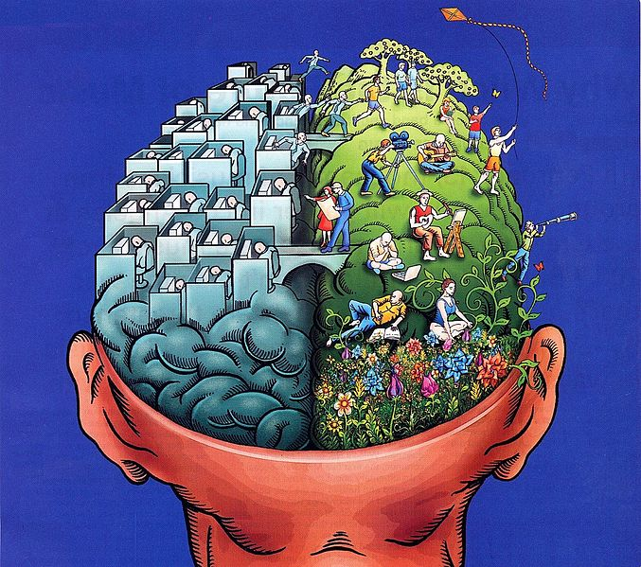
Introduction
Welcome Everyone!
Today’s Focus…how do we maintain this balance, workplace edition?
What role does our employment play in maintaining this balance?
What can we ask ourselves to help stabilize?

Slide 3
Mental Health in the workplace
The world, collectively, has experienced extraordinary changes and challenges over the past four years – the workplace is no exception. Collective trauma from the pandemic, climate disruptions, political strife, and workplace stress and burnout have reduced the gap between work, mental health, and well-being - globally.
We see where now WHO or the World Health Organization and the Surgeon General state:
The ongoing pandemic and the changes it provoked have also led more workers to view employer-provided mental health support as a right, not a mere perk. As the WHO recently noted, “Working people, like all people, deserve an inherent right to the highest attainable standard of mental health at work, regardless of their type of employment.”
Younger generations, especially, are seeking workplaces where they feel safe discussing their needs, struggles, and personal obligations—and one that provides mental health resources. This includes quality mental health benefits and a work environment designed to help prevent stress and burnout. When employers fail to invest in their employees’ well-being, employees aren’t afraid to look for an employer who will.
Notes:
1. “Work environment” is underlined – because (believe it or not) some employers actually instruct their employees to “leave whatever drama you have, leave it outside these doors (absolutely not helpful).
2. Not only should work environments ADDRESS the need they should PROVIDE resources – it is cribbling for the work environment to ignore mental health needs.
3.

Slide 4
Shift toward mental health safety: workplace
“We have the power to make workplaces engines for mental health and well-being. Doing so will require organizations to rethink how they protect workers from harm, foster a sense of connection among workers, show them that they matter, make space for their lives outside work, and support their long-term professional growth,” said U.S. Surgeon General Vivek Murthy in his recently released Framework for Mental Health and Well-Being in the Workplace. “This may not be easy. But it will be worth it, because the benefits will accrue to both workers and organizations.”
Workplace Mental Health & Well-Being — Current Priorities of the U.S. Surgeon General (hhs.gov)

Slide 5
Top 2023 Insights (national surveys)
1. Most employees face mental health struggles (for a number of reasons) – many do NOT seek help
2. Many employees struggle to get the right care
3. More people are discussing mental health at work, propelling a culture shift
4. Leaders/managers lack required mental health resources – readily available
5. Employees are increasingly stressed and burnt out, signaling a need for better work design(s)

Slide 6
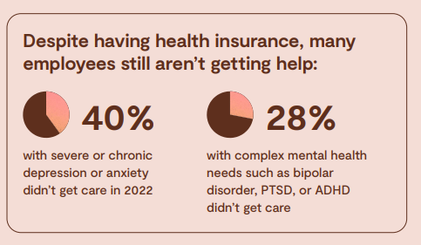
Most employees face mental health struggles
*% based on a national survey (for educational purposes)
*survey findings did shed some light on why this is happening…
(1) COVID 19 exacerbated an existing shortage or mental health professionals; presenting persons with a decision – forgo care or pay for a provider who is outside the network and does not take insurance – according to NAMI (National Alliance on Mental Illness) – cost is one of the biggest barriers to getting treatment.
(2) Stigma –despite more people discussing mental health in the workplace, many employees still fear that their reputation, relationships, or job status could be jeopardized if they disclose their mental health struggle or diagnosis at work.

Slide 7
Many employees struggle to get the right care
67% Employee benefits leaders who said it’s easy for employees to find mental health care. | 51% Worker’s who said it’s easy to find mental health care for them and their families.
This, and other survey data indicate a disconnect between employees and employers regarding the ease of finding mental health care.
Notes:
“benefit leaders” are individuals or organizations that play a prominent role in advocating for mental health benefits and services (e.g., psychiatrists, psychologists, therapists, researchers, public figures, etc.

Slide 8
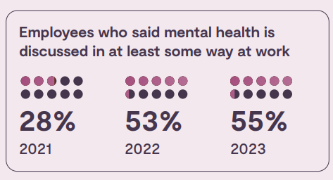
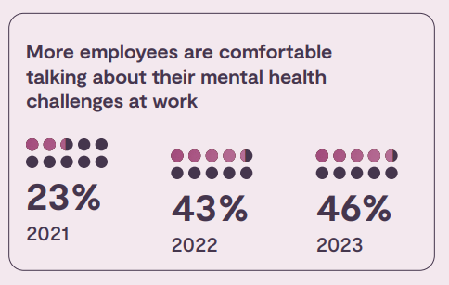
More people are discussing mental health at work, propelling a culture shift
From 2001-2003, the % of workers who said mental health is discussed in at least one way in their workplace nearly double.
More workers are talking about their own mental health challenges in the workplace – growing from 23% to 46% in 2023.
National survey findings highlight that there is still work to be done. Even though employees are speaking up more about their mental health, only about half of those employees feel comfortable requesting a mental health-related accommodation or leave of absence. Opportunity – leaders/managers to discuss their own mental health struggles; showing vulnerability and a sense of empathy, doing so creates a psychologically safe workplace.
Building_Psychological_Safety_Around_Mental_Health_at_Work_guide (intelligencebank.com)

Slide 9
Building psychological safety
1. Ice Breakers
Start beginning meetings that way
2. Team-building exercises
Supports engagement, shoulder to shoulder attitudes develop
3. Appreciation Circles
Let the team express appreciation or ONE ANOTHER (level the appreciation)
4. Active Listening
Employees pair up and practice active listening based on professional/personal stories
5. Feedback workshops
Setting designed to provide and receive feedback effectively
6. Conflict Resolution Workshops
Focus on techniques and strategies; maybe even “safe word” identification and learning how to operate around those boundaries
7. “Hair down Sessions”
Informal settings for employee feedback/sharing

Slide 10
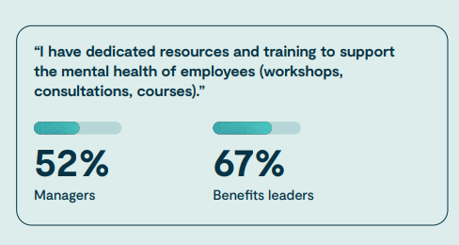
Leaders/managers lack required mental health resources
Survey data suggests that managers are doing their part to support their employees’ mental health, but it’s often under tough circumstances; in essence, spiking during shared disaster or hazard.
These findings underscore the need for more mental health resources and training for managers—especially since work-related obligations can create mental health issues for managers themselves.
According to “Trends in Behavioral Health Integration” report by Healthcare Media, “Managers are seemingly tasked with trying to do a lot with very little and end up taking on the mental burden for their staff because they’re empathetic and feel they should deal with the fallout on administrative decisions as a leader.”
27% ranked “work-related managerial stress” as one of the top 3 factors impacting their mental health
• 64% said their mental health affected their ability to do their job over the past year (vs. 57% of non-managers)
• 30% said they’re actively looking to change employers over the next year (vs. 22% of non-managers
Notes:
The dynamic of managers can be (appear) very different to that of

Slide 11
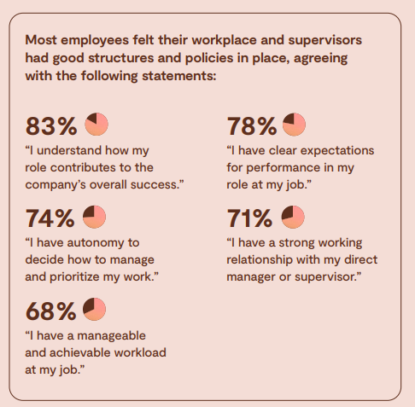
Need for better work design
Research and Assess Needs
Incorporate Nature and Natural Elements (if possible)
Create comfortable and flexible spaces
Foster collaboration and social connection
Prioritize privacy and quiet areas
Enhance lighting and color schemes
Promote movement and physical activity
Encourage mindfulness and relaxation
Provide supportive amenities and facilities
Provide training and continued support
Notes:
Do NOT try to be cookie cuter – feel out YOUR OWN employees and make sure it works for them

Slide 12
Key to mental health in the workplace
Open Communication
Encourage open dialogue and provide avenues for employees to express their concerns or seek support.
Work-life balance
Encourage employees to take breaks, use vacation time and set boundaries between work and personal life; encourage managers to be more understanding and flexible with the “outside” aspects of employees.
Stress Management
Find/Implement stress management programs – mindfulness training, yoga, stress reduction workshops.
Supportive Leadership
Ensure leaders/managers are trained in recognizing signs of mental health challenges and are equipped to provide support and resources.
Employee Assistance Programs
EAP designed to support confidential counseling services and resources (make clear, it is not a punishment, but a source of professional support).
Check-ins
Encourage leaders/managers to have regular check-ins with their team to discuss workload, stress levels, and overall well-being.
Equitable mental health care refers to ensuring that all individuals, regardless of their background, socio-economic status, race, ethnicity, gender, or other factors, have equal access to and receive fair and unbiased mental health services and support.
Notes:
These steps are for ANYONE does not have to be the leader/manager.

Slide 13
Significance of mental health in the workplace
Employee Well-being
Reduce absenteeism and presenteeism
Positive Work Culture
Decrease Stigma
Legal and ethical obligations
Cost Savings
Notes:
1. Employee Well-being: good/safe structures for supported mental health leads to happiness, motivation, and engagement in the workplace – leads to high productivity, creativity and job satisfaction.
2. Reduce absenteeism and presenteeism: Prioritizing mental health – employees reduce absenteeism thus improving overall work performance and efficiency. “presenteeism” refers to employees who come to work but are not fully productive due to physical or mental health issues.
3. Positive Work Culture: Prioritizing mental health creates a supportive and inclusive work environment.
4. Decreased Stigma: By openly addressing mental health in the workplace, organizations can help reduce the stigma often associated with mental health challenges.
5. Legal and Ethical Obligations: Many countries have laws in place that require employers to have a safe and healthy workplace to include addressing (head on) mental health and methods to support it.
6. Cost Savings: Investing in mental health initiatives can lead to cost savings for employers – For every dollar spent on mental health services, organizations see a return of up to 4 dollars through increased productivity and reduced healthcare costs.

Slide 14
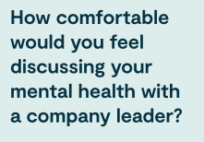
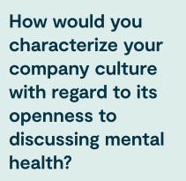
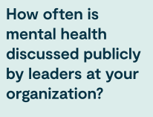
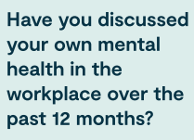
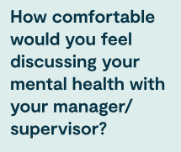
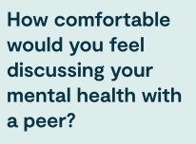
Company Culture

Slide 15
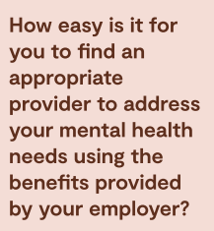
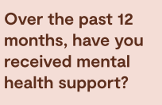
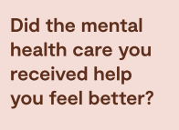
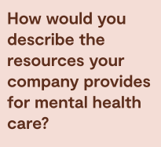
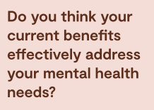
Access to Mental Health Care

Slide 16
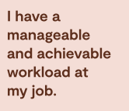
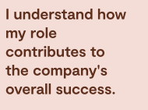
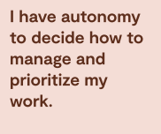
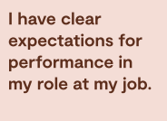
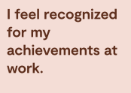
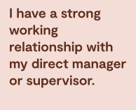
Work Design

Slide 17
Resources
Virgin Islands Department of Health
https://doh.vi.gov/programs/behavioral-health-alcoholism-and-drug-dependency
National Helplines:
988 Moving to the new 988 number does not mean the 1-800-273-8255 number goes away. After July 16, 2022, using either number will get people to the same services. Veterans, Service Members, and their families can press option 1 for services the same way they did when calling the 1-800-273-8255 number and Spanish speaking individuals can continue to utilize option 2 for assistance.
Crisis Text Line: Text "HELLO" to 741741
Online Mental Health Platforms:
BetterHelp: Online counseling and therapy platform.
Talkspace: Online therapy with licensed therapists.
Mental Health Organizations:
National Alliance on Mental Illness (NAMI): Provides support, education, and advocacy for individuals and families affected by mental health conditions.
Mental Health America (MHA): Offers screening tools, resources, and information on mental health topics.
Psychology and Mental Health Websites:
American Psychological Association (APA): Provides information on various mental health topics and resources to find psychologists.
Mayo Clinic: Offers reliable mental health information, self-help resources, and access to specialists.
Mobile Apps:
Headspace: Provides guided meditation, sleep aids, and mindfulness exercises.
Calm: Offers meditation, sleep stories, and relaxation techniques.

