Slide 1


5 Essentials of Health

Slide 2
State of the Union
The U.S. spends $2.3 TRILLION annually on healthcare
The WHO ranks the healthcare of the U.S. 37th and Canada 30th among organized nations
75% of healthcare costs are accounted for by chronic diseases
For the first time ever, parents are expected to live longer than their children.

Slide 3





The 5 Essentials
Essential #1: Maximized Mind
Essential #2: Maximized Nerve Supply
Essential #3: Maximized Nutrients
Essential #4: Maximized Oxygen &
Lean Muscle
Essential #5: Minimized Toxicity
Notes:
Now that you’ve instituted the challenge and set a big goal, you are going to show them how to get it done. The turning point:
“The answer to any of your health problems that you walked in here with is already inside you- it’s the 5 Essentials.”

Slide 4
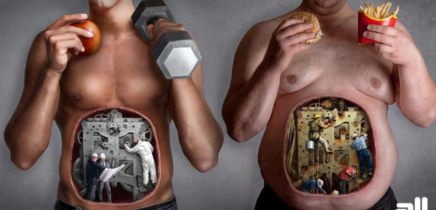
Are you healthier now than you were 5 years ago?

Slide 5

WHY?
If a person has a big enough why, they can endure almost any how.
Notes:
MAX MIND
This is the big question.
So you know what to eat, why don’t you do it? Because your why isn’t big enough.
Wanting to be healthy or lose a few pounds is not a big enough why. I go through mine from the book and show them what a big why looks like. It has to relate to your potential or doing it for someone else. Someone told me that she wants to be around to pass her faith on to her granddaughter and she needs to be healthy to do it. That’s a big why.
Activity: Give your audience a minute to write down their big why in their book, and then break up in pairs to share it. You can ask people to share with the group also.

Slide 6
Where does stress come from?
CHRONIC
STRESS
Chemical
Toxins
Diet
Environment
Physical
Traumas
Subluxation
Psychological
Thoughts
Anxiety
Notes:
So where does chronic stress come from? Everywhere! The three T’s. Toxins, traumas, and thoughts. Toxins are the things that are innately toxic to your body, chemicals, foods, the environment. Traumas are the physical stresses on our body from sports injuries, slips and falls, car accidents, and our lifestyle stresses – most importantly the effects of our sedentary lifestyles. And thoughts, how you think.
It would be overwhelming to unpack each of these categories in detail today. We’d be here all night. So we’re going to hit the big ones and focus on how you eat (toxins), how you move (traumas), and how you think (thoughts).
What you must understand is that your body doesn’t differentiate. Stress is a stress is a stress to the body.

Slide 7
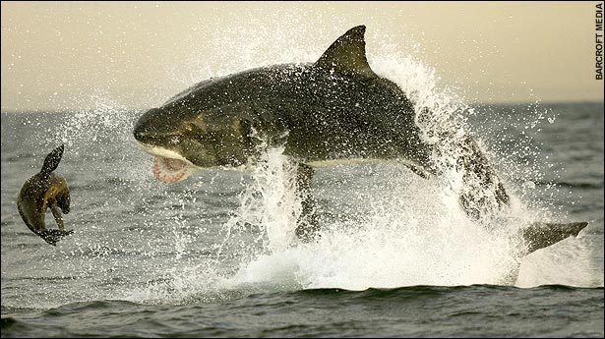
Stress:
Stimulus (Threat)
Stress Hormones Released
(ACTH, Glucocorticoids, Adrenaline, Noradrenalin)
“Fight or Flight” Physiology:
Blood pressure / Heart rate / Blood sugar / Blood lipids / Clotting factors
Eyes Dilate / Muscles Contract / Breathing Rate Increases
Vision and Hearing Sharpens / Focus Narrows / Long-term memory reduced
Immune system / Digestion / Reproduction down-regulated
This system is designed to work perfectly when you can
GET AWAY FROM the perceived threat.

Slide 8
Nutrition

Slide 9
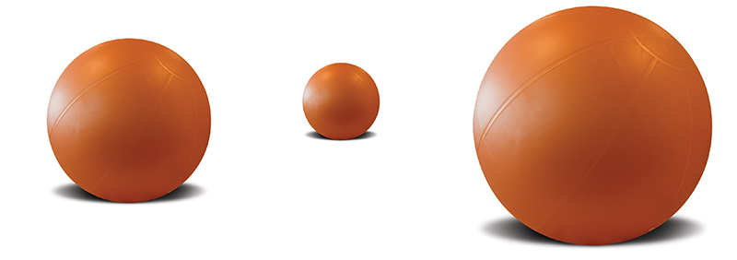

What Makes You Go?
Your body uses one of two things for energy:
Sugar (Glucose)
Fat
Therefore, you’re either a sugar burner or a fat burner.
Notes:
FITNESS
Urban Legend: In order to burn fat, you need to spend at least 20 minutes in your “Fat Burning Zone”
Truth: It’s not important what you burn during your exercise, it’s what you burn AFTER the exercise. You can burn more fat in 12 minutes than 1 hour with Surge Training.
CONS That Occur AFTER Classic Condition (Low Intensity, Long Duration)
Raises stress hormones. Stress hormone Cortisol stimulates appetite,
is catabolic (breaks down muscle), increases fat storing,
and slows down or inhibits exercise recovery
Decreases testosterone and Human Growth Hormone (HGH) both necessary for building muscle and burning fat
Decreases immune function post exercise

Slide 10
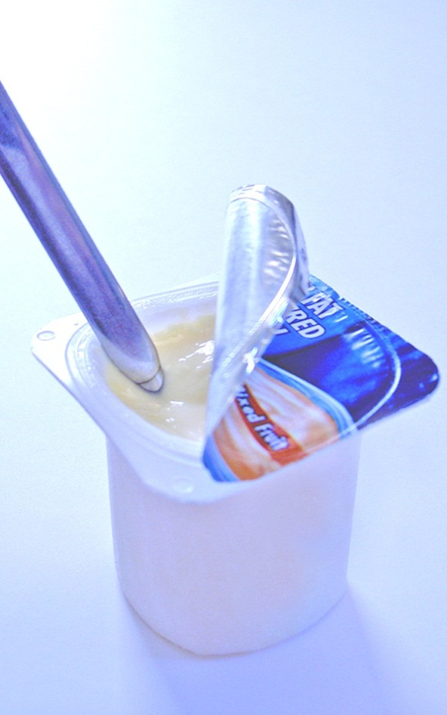

Fat Has a Bad Rap
The non–fat movement escalated in the 60’s and 70’s.
Butter and meat consumption dropped by approximately 50% during this time.
Margarine consumption rose 400%
Heart disease rose dramatically.
Notes:
Point of this slide is: everything you’ve been taught by conventional “wisdom” is wrong! Get them to realize that they need to start thinking differently and that’s what you are providing- a different way of thinking based on how their bodies are designed to work.

Slide 11
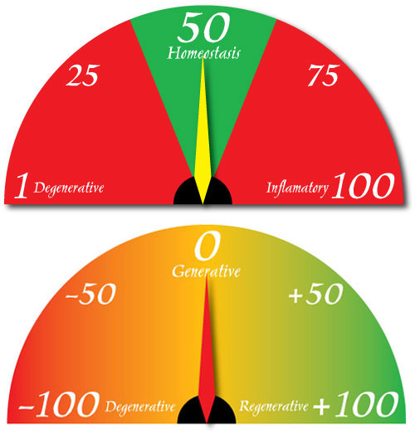
Sugar Makes Us Fat!!!
Your body can function with only 1-2 teaspoons of sugar in the bloodstream.
More than that risks your body coma and even death!
To avoid this, your body knows just what to do…
STORE EXCESS SUGAR AS FAT!

Slide 12
Sugar – How much?
53 teaspoons of sugar/day = one 5 lb bag of sugar every ten days for every man, woman, and child. (Robbins, 2006)
High-fructose corn syrup has increased from ZERO in 1966 to 63 pounds/person per year in 2001! And it’s getting worse… (Mercola 2004)
HFCS has caused an increase in daily intake from 27 tsp/day (2004 statistic) to 53 tsp/day (2006 statistic).

Slide 13
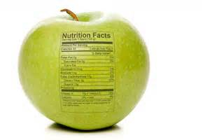
Goal
Eating foods that are intended for our bodies
Foods in their most natural state

Slide 14
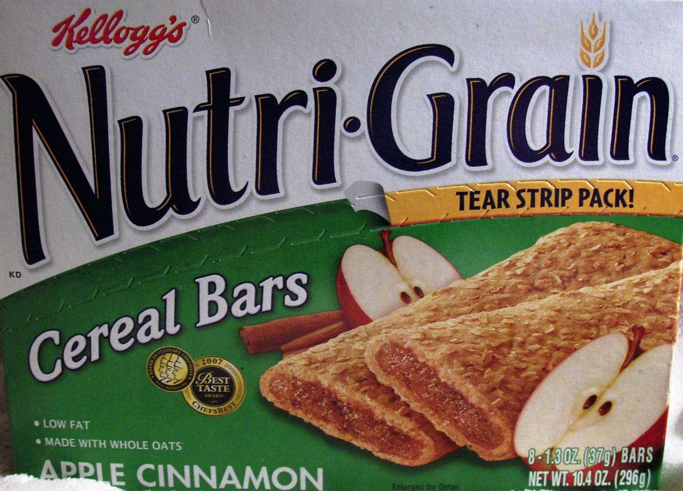
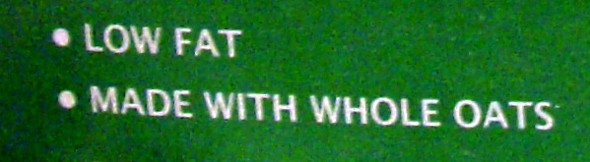

Slide 15
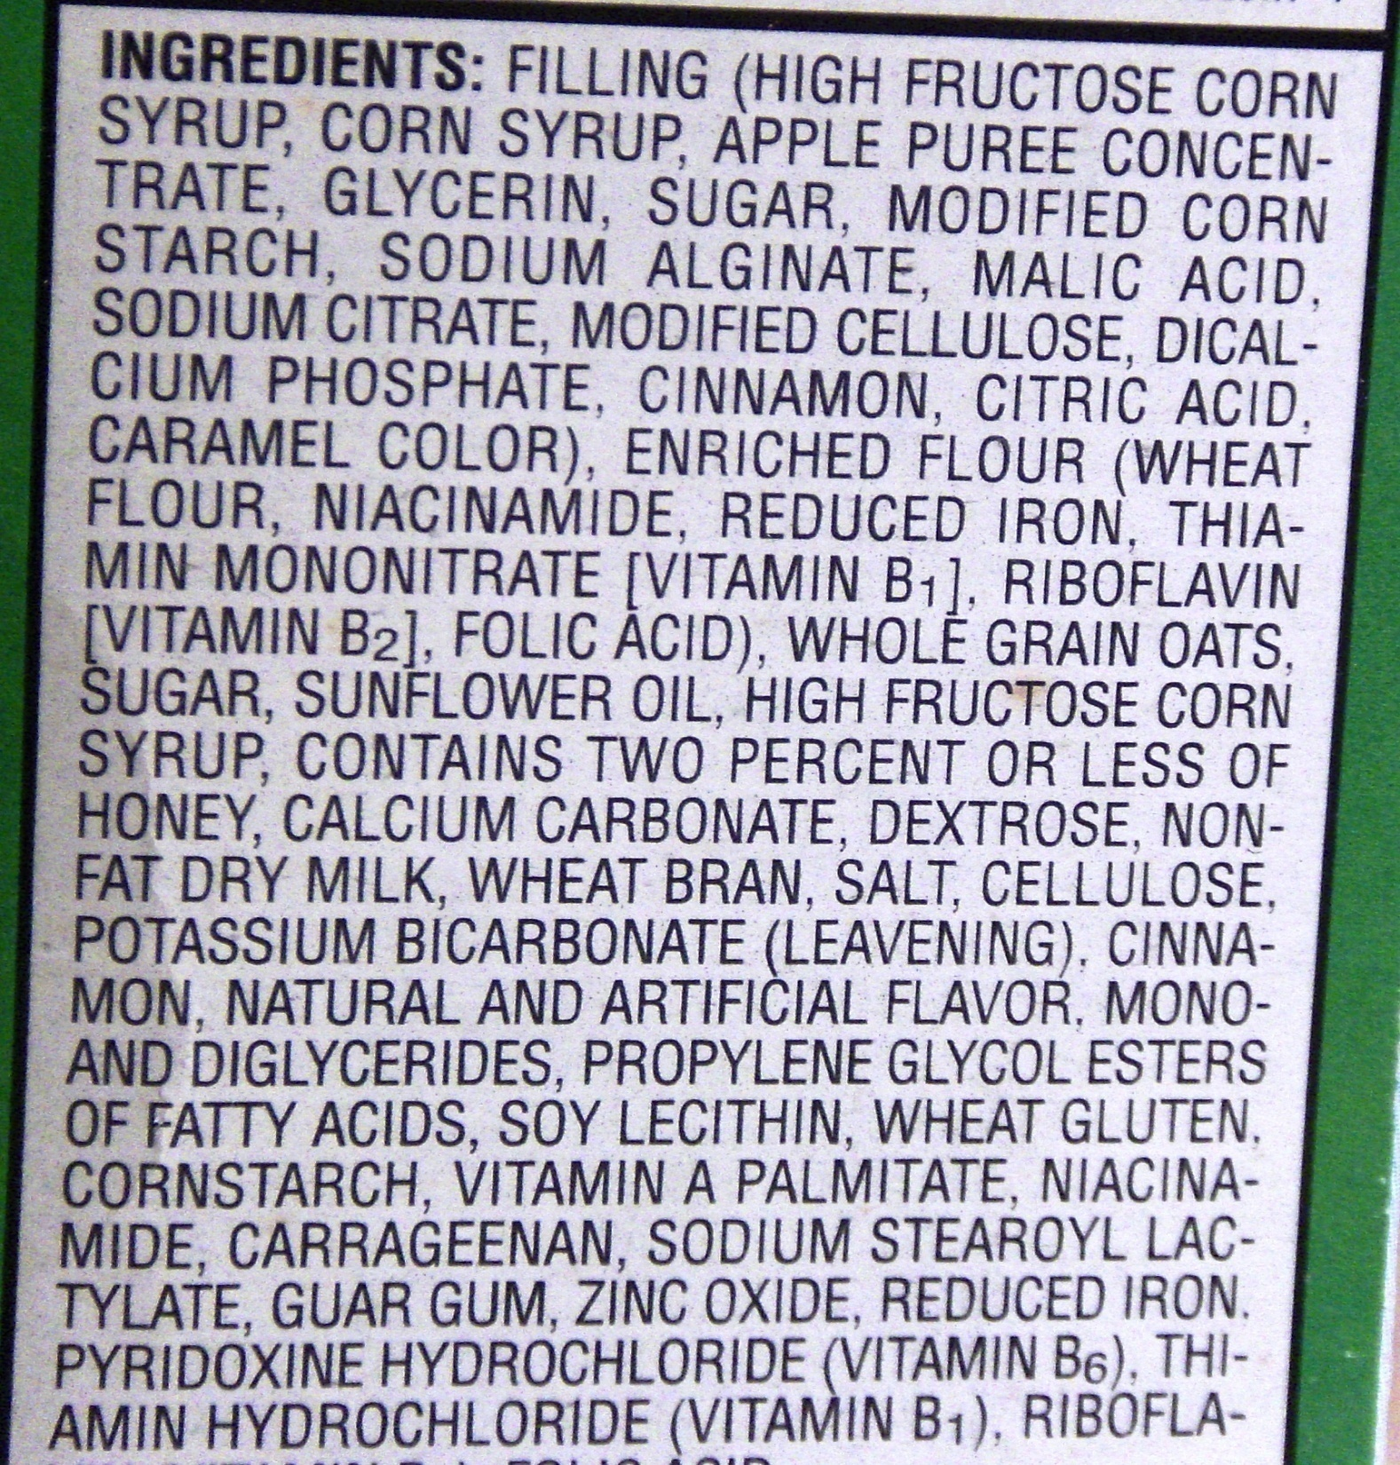

Slide 16
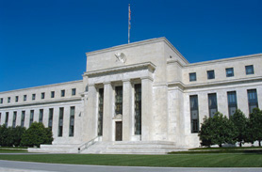

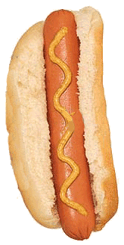





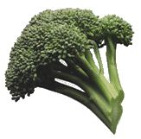
YOUR ENERGY BANK
Withdrawal
Deposit
Alkalize Your Body — Energize Your Cells
Acid
PH
Alkaline
1 2.85 4.0 4.5 5.0 7.365 7.6 7.8 7.8 10.5 14
Balance
You Are in Control of Your Energy
Take Charge Now
Notes:
Dehydration is one of the ways your body becomes very acidic.
The cells in our body are bathed in a fluid. They need that fluid to be 7.365. That’s the normal pH level. It’s the alkaline acid balance in your body.
Certain things will push you to acid where disease forms.
And certain things will make you hydrated and that’s where you want to be.
Taking in things like sugars, preservatives, beers, processed foods, dairy, etc will also lead to acidity in your body.
If your dehydrated, you will become acidic. So drink ½ your body weight in water.
You want your bodies internal envirnoment to be slightly alkaline for optimum function and healing.

Slide 17

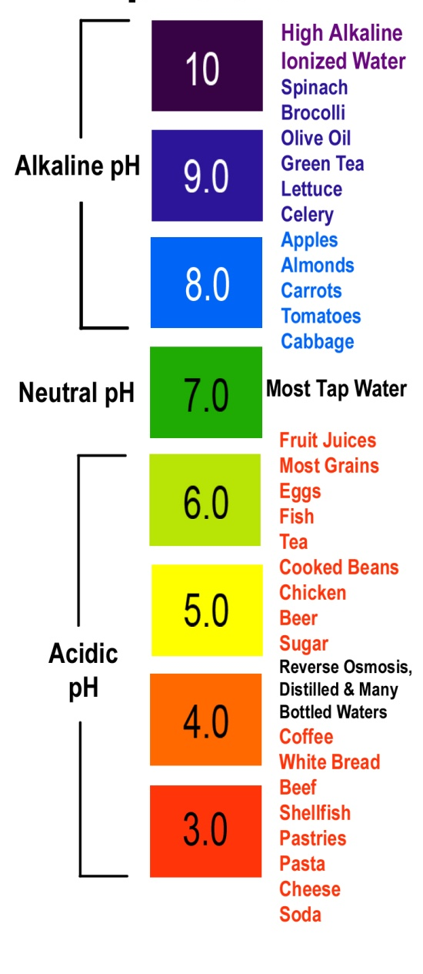
pH
It takes 30 cups of water to neutralize 1 can of soda
It takes 30 cups of water to neutralize 1 can of soda
Notes:
BJ

Slide 18
Exercise

Slide 19
Best Time to Exercise
First thing in the morning on an empty stomach
  Best compliance
  Raises growth hormone
  Testosterone highest
  Insulin lowest so aids with fat burning
  Turns on metabolism

Slide 20
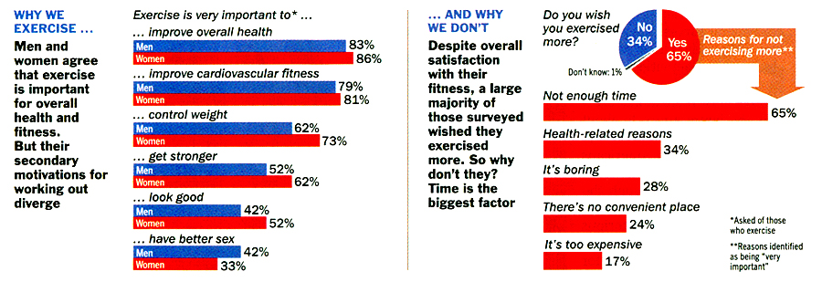
Why We Exercise
…And Why We Don’t
Time Magazine June 6, 2005

Slide 21
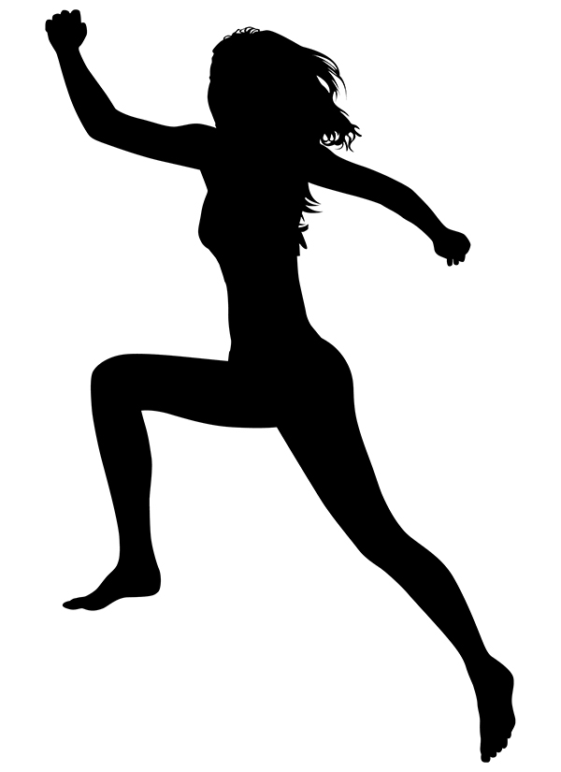
Metabolic Conditioning
Conditioning exercises that elicit a specific hormonal and energy production response designed to improve the capability of the body to efficiently and effectively deliver energy for activity
It is characterized by short surges of high intensity exercise
Exercising at 90% to 100% of maximal heart rate
12 minutes of exercise a day
Notes:
Contrast the cons of classic cardio with the exercise type that is designed for maximum results:
Metabolic conditioning is not about building bigger muscles, decreasing heart disease, or improving performance - although it definitely will help with all three. Metabolic exercise is about burning the maximum amount of calories (specifically fat calories) possible during a workout. It is also about generating a metabolic “ripple” effect that will burn fat for many hours after the workout. This sounds like marketing hype to most people, but this is exactly what research has shown is possible and what metabolic training attempts to produce. If the workout is done with sufficient intensity, and the diet is in-line, it can even ignite fat burning for days.

Slide 22
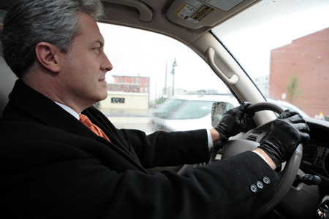



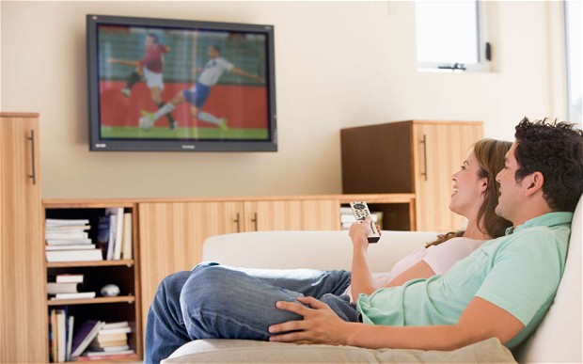
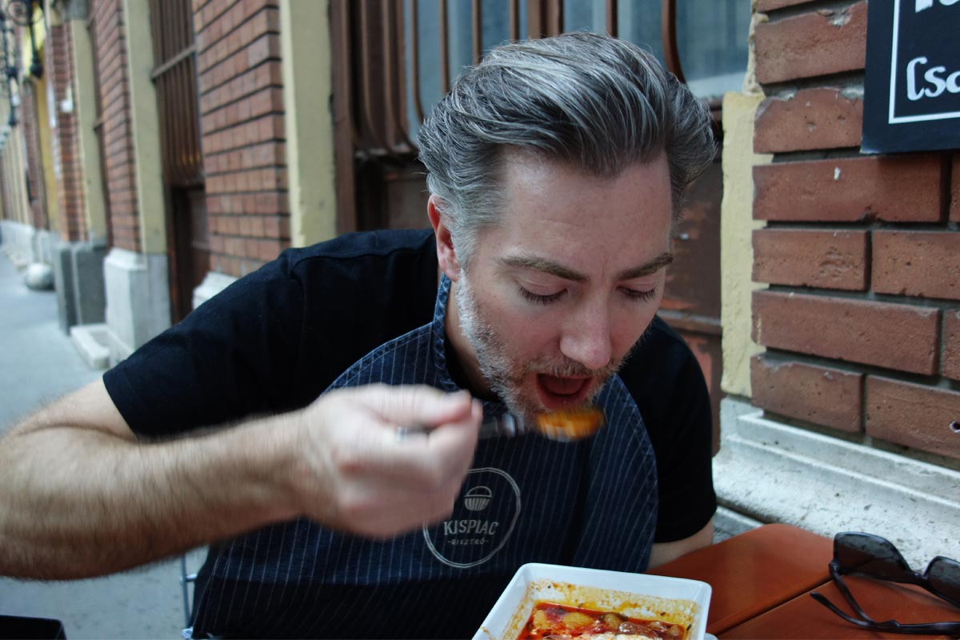

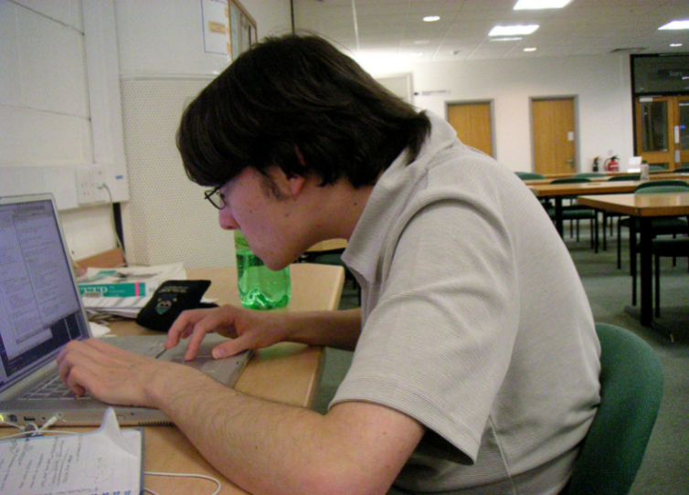
BAD HABITS
ADD
TOGETHER

Slide 23
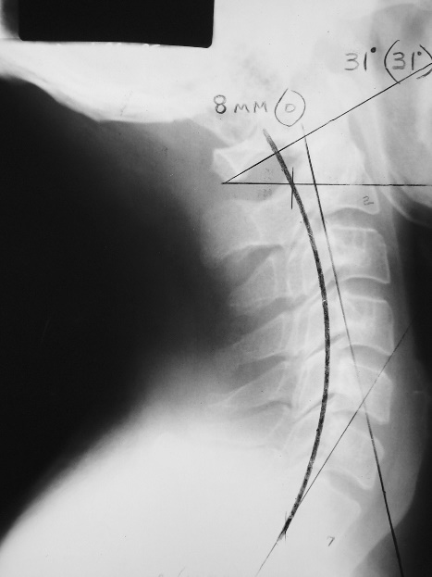
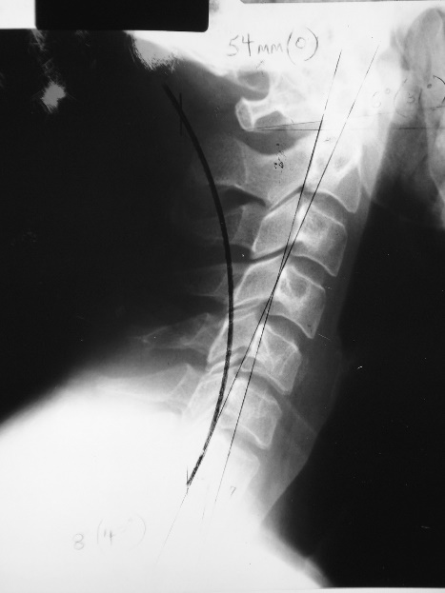
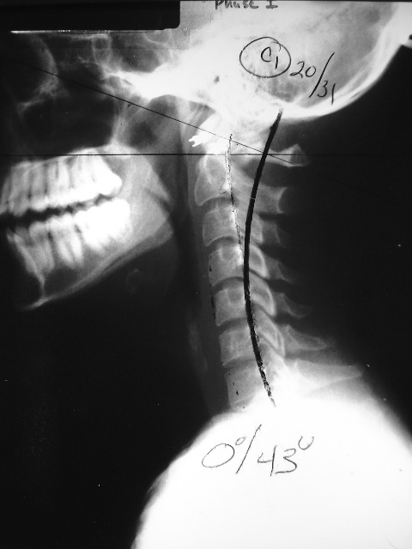
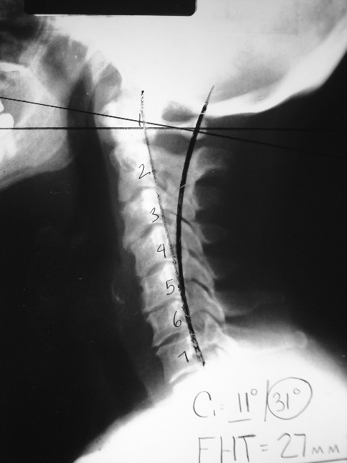
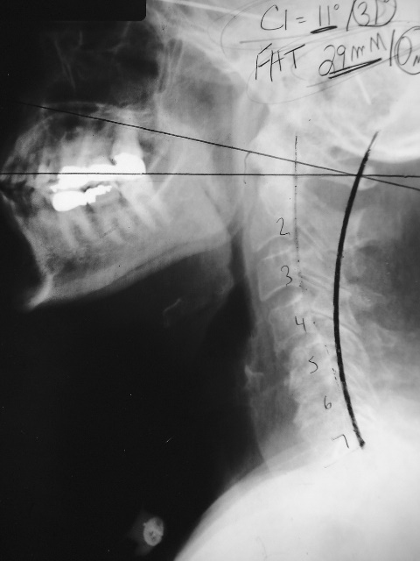
Cervical Curve
Phase 1
Phase 2
Phase 3
Notes:
Losing those curves can be devastating to body function.
When your neck looks like this, there is actual tension on the spinal cord.
Progressive kyphosis of the cervical spine (a loss or reversing of the neck’s curve) results in the destruction of nerve fibers due to chronic compression of the spinal cord.
A problem like this is what causes headaches, neck pain, carpal tunnel, and many other illnesses

Slide 24
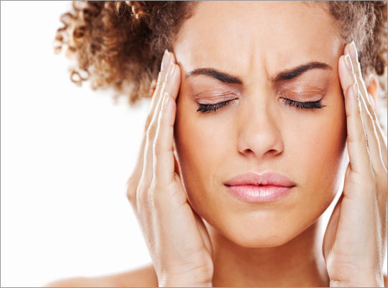
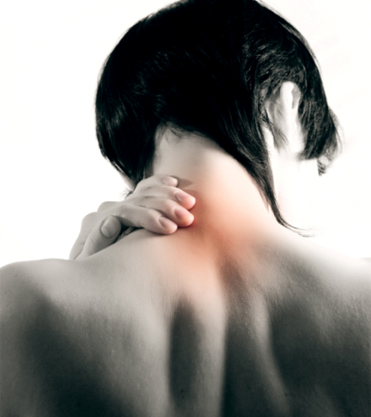
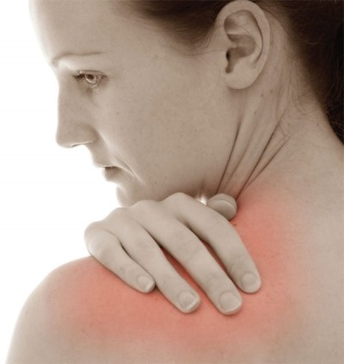
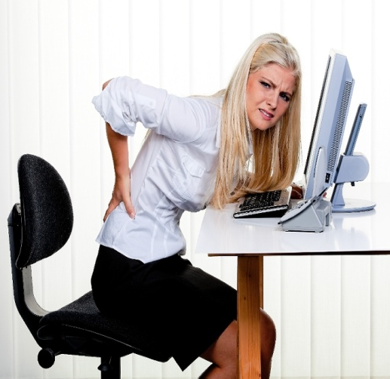
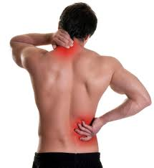
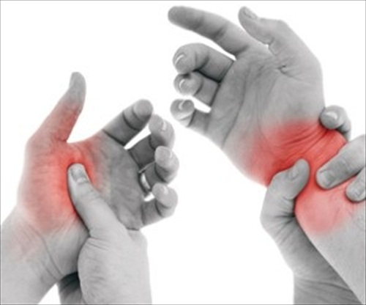
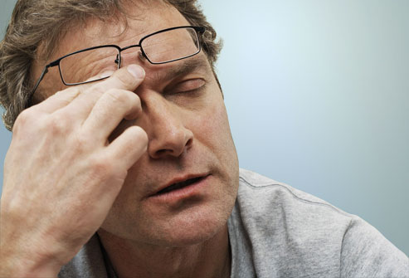
Body Signals
Headaches
Neck Soreness
Shoulder Stiffness
Back Pain
General Muscle Pain
Repetitive Stress (Carpal Tunnel Syndrome)
Eye Strain
Notes:
As much as 77% of an office workday is spent sitting in front of a computer, twisting our body into weird tetris blocks, for the most part unmoving, on chairs. That much sitting causes stress. And stress disturbs the body’s homeostasis – a body’s balance. And a stressed body leaves itself open to attack.
And this is what we’re seeing? How many of you look like this at work? 1/4 of the US workforce thinks pain, symptoms, are just part of having a job.
Headaches, neck soreness, shoulder stiffness, back pain, CTS, eye strain. These are just some of the physical body signals everyone is experiencing.
The way we work, how we live our lives, is consistently and progressively breaking down our structure and the nerve system it protects.
And this is just the physical stress of how we spend 40+hours a week. What about the mental stress? The emotional stress? The chemical stress of a toxic deficient lifestyle? We won’t go into that tonight, there will be a time for that. But this all affects the function of our nervous system.

Slide 25
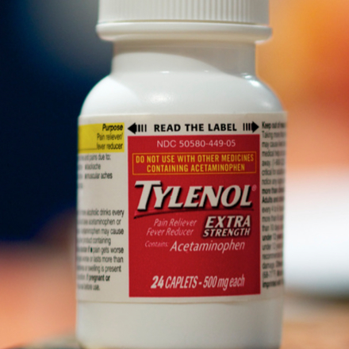
Notes:
So how do we take care of our symptoms today? For example, headaches.
That is right. We take drugs like Tylenol
But what happens a couple days later or weeks later?
Pain and symptoms return.
That is because you covered up the pain with the drugs you were taking, but you did not take care of the cause.

Slide 26
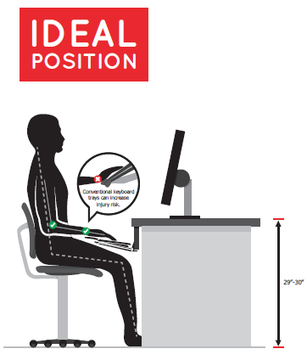
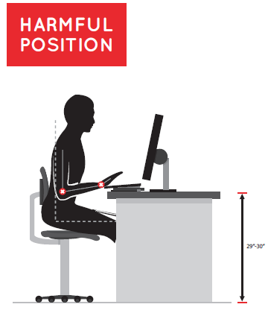
Posture at Work
Notes:
So earlier I mentioned that the vast majority of work injuries do not occur because of an accident, but because of repetitive motions. If we look at what you do in your daily life, what is causing you to lose those curves?
In your neck, you can begin to lose those curves by looking down while reading or at a computer for an extended period of time in the day. How many of you have posture that is similar to the illustration on the right?
Now that we see that this position is harmful we can begin to reevaluate our posture and correct some of the damage that we are causing to our bodies. Look at the picture on the left, this is what we should strive for.

Slide 27
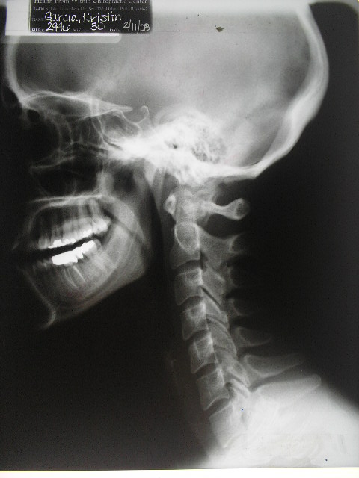
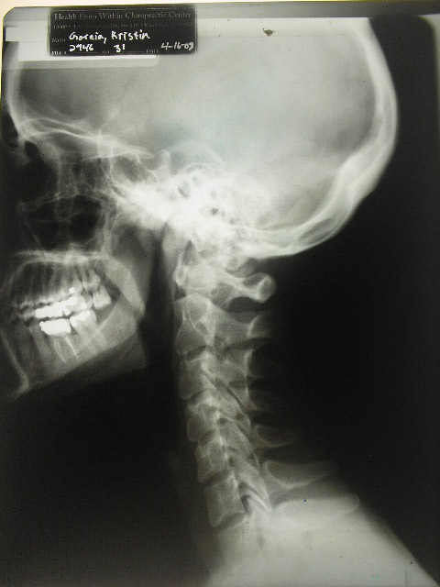
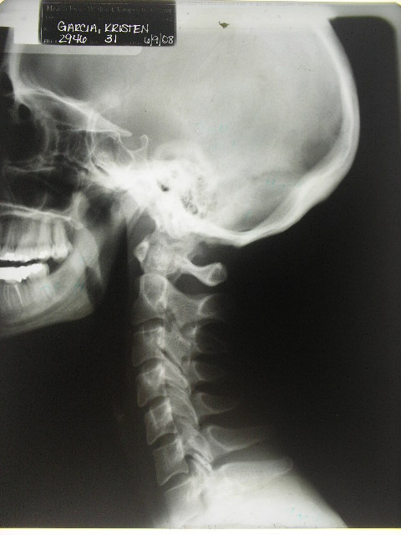
Corrective Care vs. Relief Care

Slide 28
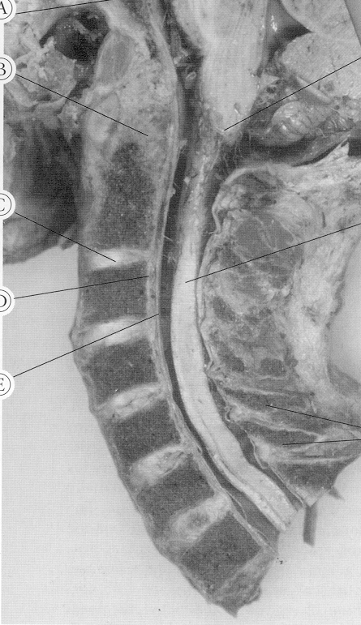
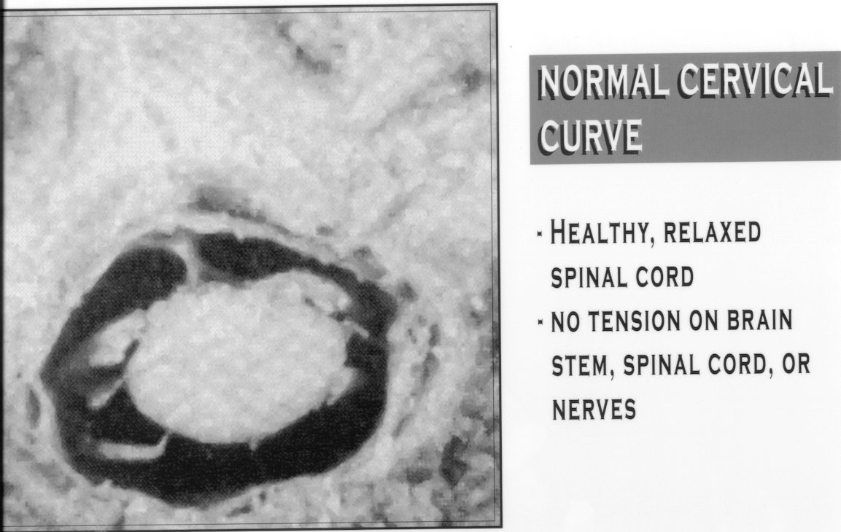
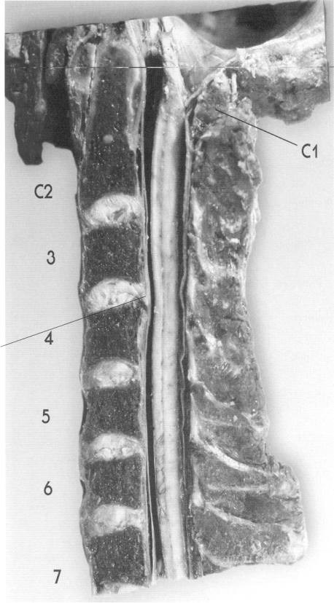
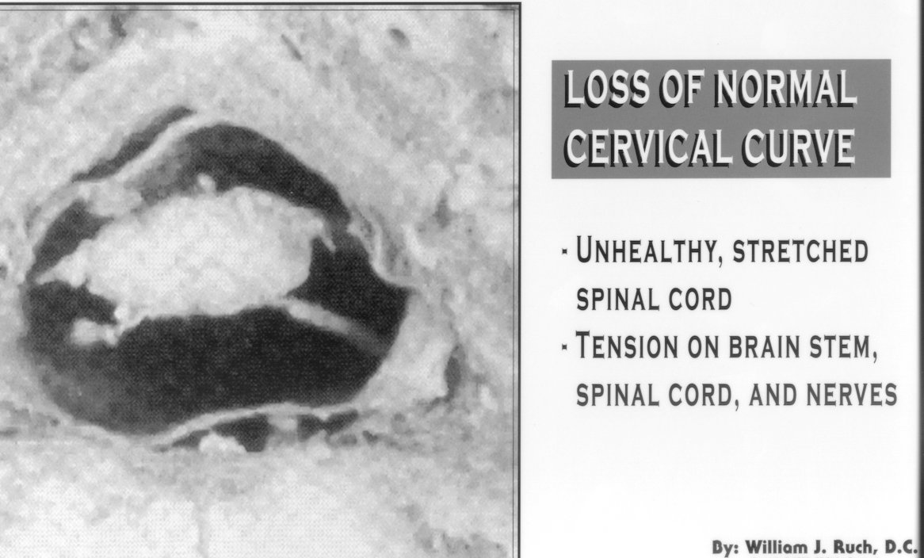
Spinal Subluxation
Progressive kyphosis of the cervical spine (a loss or reversing of the neck's lordosis) results in destruction of nerve fibers due to chronic compression of the spinal cord.
"Spine" Volume 30(21), November 1, 2005 pp. 2388-2392 revealed work done by Shimizu, Kentaro MD; Nakamura, Masaya MD;
Nishikawa, Yuji MD; Hijikata, Sadahisa MD; Chiba, Kazuhiro MD; Toyama, Yoshiaki MD.

Slide 29
Remember The Causes of Subluxation
Genetics
  50% of the time there is a genetic link
Birth
  German study found that 80% of Babies are subluxated at Birth!!!
Slips, Falls, Accidents/Trauma
  5,000 Falls by the age of 3 & 2,500 spinal traumas be the age of 5
  Imagine running straight into the wall

Slide 30
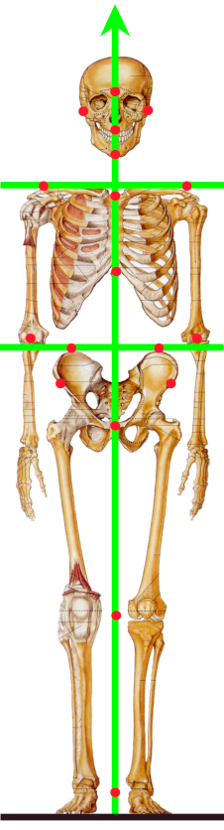
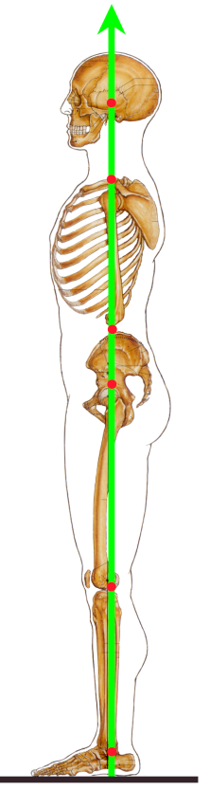
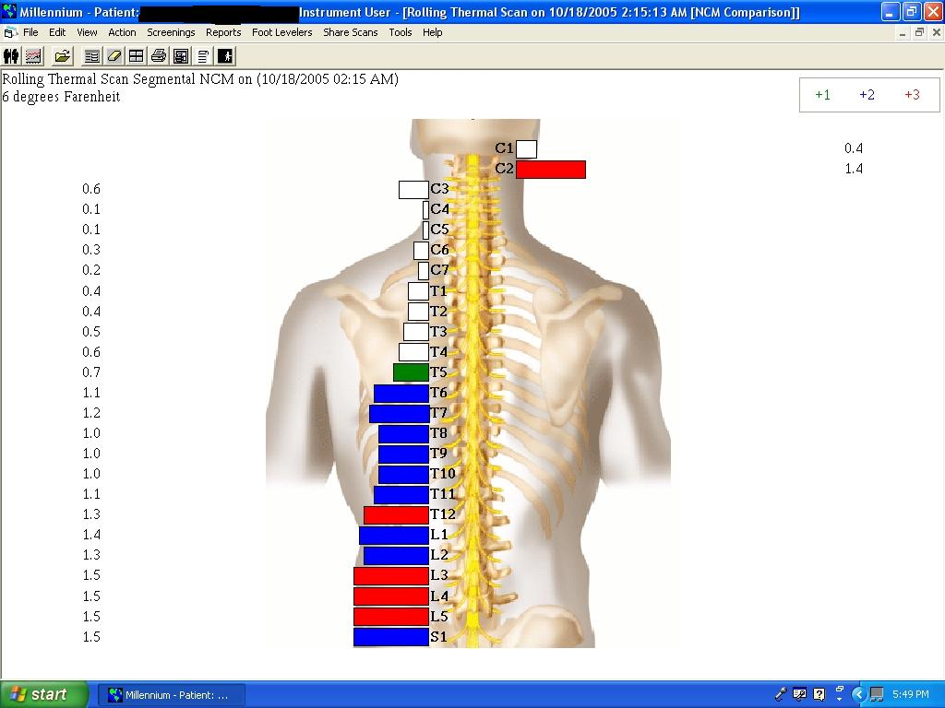
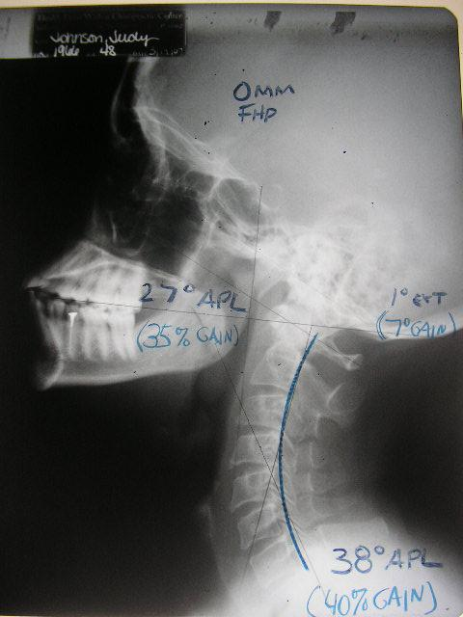
How Do YOU know if You or Your Child Has Subluxation?
The three primary methods for evaluating nerve supply:
1) Posture
3) Structural X-rays
2) Nerve Scan

Slide 31
Monthly Health Talks

Slide 32

St. Croix
340.713.4326
Peters Rest Shopping Center
St. Thomas
340.714.4325
Al Cohen Plaza, Raphune Hill
www.paradisechirovi.com
Notes:
You will be offering encouragement and resources online as well as at your clinic. This is where you can get new patients plugged into your newsletter and social media properties.

