Slide 1
Hot Topics in Medicine
Dr Jessica Wilson
Internal Medicine & Pediatrics
Affirm Medical Spa

Slide 2
Introduction
With the ever-growing presence of online health information, it can be confusing to navigate between what is factual and what is “healthcare influencer” information.
Today we will hit the hot topics in Medicine that concern everyone.

Slide 3
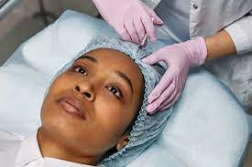
Hot Topics in Medicine
Obesity and Weight loss
Sexual wellness

Slide 4
Obesity and Weight loss
What’s the real deal?

Slide 5
Obesity rates have tripled

Slide 6
The Future (If we don’t change)

Slide 7
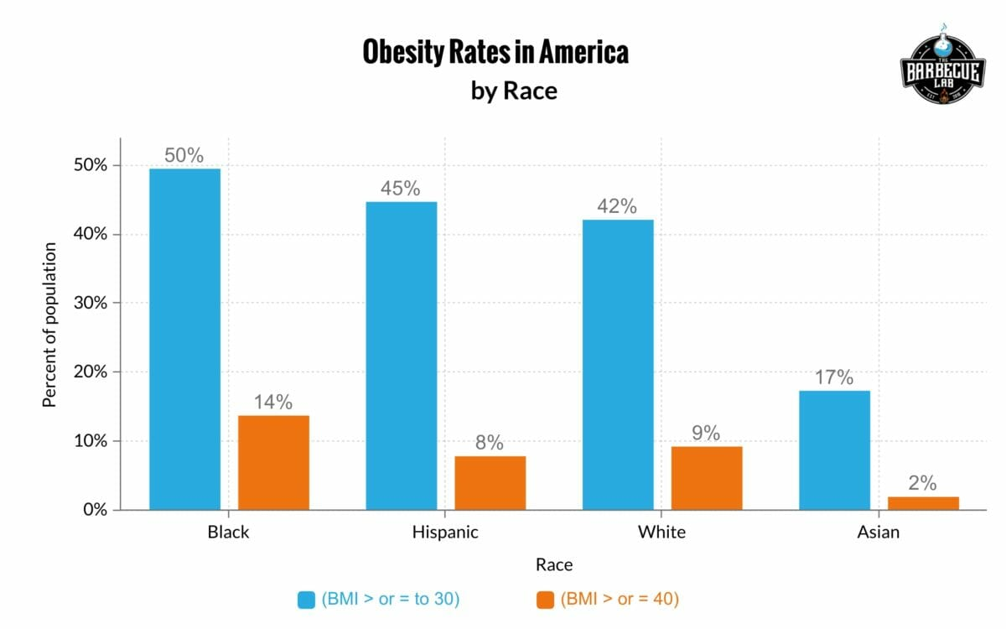
Obesity by Race in 2023

Slide 8
What about the children?

Slide 10
Choose the healthier food items

Slide 11
Choose the healthier food items

Slide 12
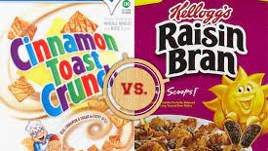
Which is healthier?
Which Cereal has the most sugar?
What about sodium?

Slide 13
Which is healthier?

Slide 17
Let’s try again. Choose the healthier food items

Slide 18
Let’s try again. Choose the healthier food items

Slide 19
All Calories are not equal

Slide 20
How to read a nutrition label

Slide 21
Super size me: Controlling our portion sizes

Slide 22
Serving size vs reality

Slide 23
Making smart choices

Slide 25
The way to get started is to quit talking and begin doing.
Walt Disney

Slide 26
Is there a quick fix?

Slide 27
New medications for weight loss

Slide 28
Not so fast, there are requirements

Slide 29
I could go on and on about Obesity but…

Slide 30
Often googled but rarely talked about by your doctor

Slide 31
Sexual wellness: Benefits of sex
Physical
Preventative
Emotional
Counts as Exercise
Improves Women's Bladder Control
Lessens Pain
Helps Keep Your Immune System Humming
Lowers Your Systolic Blood Pressure
Lowers Heart Attack Risk
May Make Prostate Cancer Less Likely
Improves Sleep
Eases Stress
Boosts Your Libido

Slide 33
Sexual Dysfunction: Who’s to blame

Slide 34
Look out signs for Men
Early ejaculation can develop because of medication, nerve damage, or other direct urinary conditions
A change in libido or erection may be the first sign of diabetes
Problems with libido or erection may be related to a hormonal imbalance
Problems with erection may be a sign of a cardiovascular issue or prostate cancer

Slide 35
Look out signs for women
Low sexual desire.
Sexual arousal disorder. Your desire for sex might be intact, but you have difficulty with arousal or are unable to become aroused or maintain arousal during sexual activity.
Orgasmic disorder. You have persistent or recurrent difficulty in achieving orgasm after sufficient sexual arousal and ongoing stimulation.
Sexual pain disorder. You have pain associated with sexual stimulation or vaginal contact.

Slide 36
Look out signs for women
Certain medications including some antidepressants, blood pressure medications, antihistamines and chemotherapy drugs, can decrease your sexual desire and your body's ability to experience orgasm.
Lower estrogen levels after menopause, childbirth, and breast feeding may lead to changes in your genital tissues and sexual responsiveness.
A decrease in estrogen leads to decreased blood flow to the pelvic region, which can result in less genital sensation, as well as needing more time to build arousal and reach orgasm.
vaginal lining also becomes thinner and less elastic leading to painful intercourse (dyspareunia).

Slide 37
A deeper look into sexual abuse
Untreated anxiety or depression can cause or contribute to sexual dysfunction, as can long-term stress and a history of sexual abuse.
as many as 1 out of 4 girls and 1 out of 6 boys will experience some form of sexual abuse before the age of 18
Children are most often sexually abused by someone they know and trust.
75% of reported cases of child sexual abuse are committed by family members or other individuals who are considered part of the victim’s “circle of trust.”

Slide 38
Shameless Plug time!!

Slide 39
Upcoming Events

Slide 40
The Premier Medical Spa in the US Virgin Islands

Slide 41
Events
30% off all
P-shots and
O-Shots if
Booked by
July 31st!

Slide 42
Yes men, the spa isn’t only for Ladies
Laser Hair removal
Laser line up
Manscaping
Medical Massage
Stretch sessions
Medical/Sports/Deep tissue massage
Hair restoration

Slide 44
Yes men, we the spa isn’t only for Ladies
Sculpting/Contouring/Fat removal
Dark spot removal
Vampire Facial
Erectile dysfunction treatment
98% Satisfaction rating for men

Slide 45
Woman’s service

Slide 46
Body Contouring

Slide 47
Hair restoration

Slide 48
Photofacials=>Sunspot removal

Slide 49
Recent Cosmetic Surgery??

Slide 50
Got Hair?? We remove it!
Bikini
Underarms
Face
Chest
Arms
Legs

Slide 51
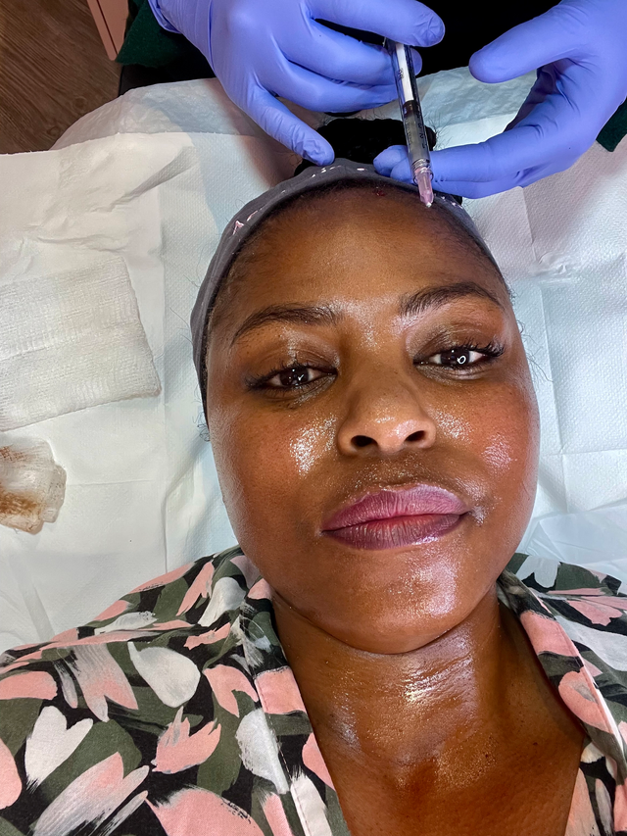
PRP treatments: O-Shot, Vampire Facial

Slide 52
Team Captain
Dr Jessica Wilson
Internal Medicine and Pediatrics

Slide 53
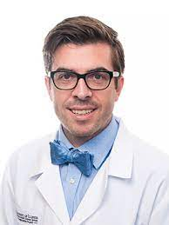
Starting Line-Up
Dr Ronayne Pediatrics
Dr Starkman Neurology and Pain Medicine
Dr Douglas Family Medicine
Dr Sagiv Cardiology and Vascular Medicine

Slide 54
Thank you
Dr Wilson

