Slide 1
Division of Personnel Benefits for Retirees Open Enrollment 2023/2024

Slide 2
Open Enrollment
This Benefit Open Enrollment Session is brought to you by:
Director of Personnel
Chief of Group Health Insurance, Ms. Valerie Daley
GESC/Health Insurance Board of Trustees

Slide 3
Open Enrollment
Introductions
Jodi Beale, Gehring Group
Malena Mayea, Cigna
Sheri Harmon-Butts, UHC
David Scearce, The Standard
Allison Allman, Bentek

Slide 4
Open Enrollment
From August 14th through September 15th, 2023
Time of year employees and their dependents can make changes to their benefit plans offered through the Government Insurance Plan
Elections will be effective October 1, 2023 through September 30, 2024

Slide 5
Open Enrollment Highlights
Medical Coverage for underage 65 will remain with Cigna with same plan option
Medical Coverage for over age 65 will remain with United Healthcare
Plan Year beginning January 1
Dental Coverage will remain with Cigna
Vision Coverage will remain with Standard with same plan option
Life will remain with The Standard with same plans

Slide 6
Cigna Medical Highlights (Under 65)
Cigna Presentation – Malena
Digital ID Cards
Preventive Care
Primary Care Designation (PCP)
Employee Assistance Plan (EAP)
MDLive – Virtual Care

Slide 7
Medical Open Access Plus Plan (OAP) Retirees Under 65
Medical Service | OAP Network | Out of Network
Calendar Year Deductible (CYD) | $500/$1,000 | $1,000/$2,000
Out of Pocket Max | $5,000/$10,000 | $10,000/$20,000
Physician Office Visit (PCP) | $20 | 40% after CYD
Specialist Office Visit | $30 | 40% after CYD
Clinical Lab (Blood Work) | 20% after CYD | 40% after CYD
Advanced Imaging (MRI, CT, PET) | 20% after CYD | 40% after CYD
Inpatient Hospitalization | $100 per admit, 20% after CYD | $100 per admit, 40% after CYD
Outpatient Hospitalization | 20% after CYD | 40% after CYD
Emergency Room | $50, 20% after CYD | $50, 20% after CYD
Urgent Care | 20% after CYD | 40% after CYD
Notes:
This slide explains the benefits of the OAP Base Plan. The Base Plan has in and out of network benefits, so you have the freedom of choice although, you will pay less out of your pocket when using a provider that is in Cigna’s Open Access Plus Network. The in-network calendar year deductible, or CYD, is $500 individual and 1,000 family. The Calendar Year Deductible is lower when using a provider that is in Cigna’s Open Access Plus Network. The in network copay for a PCP Office Visit is $25 and the copay is $35 when going to a Specialist Office Visit. Since there is a copay for an office visit, you do need to worry about meeting the deductible, you simply pay the copay. The calendar year deductible, or CYD would apply where ever you see 20% coinsurance. For example; the deductible would need to be met for x-rays, blood work, advanced imaging, urgent care, hospitalization, and emergency room services. The out of pocket maximum is your safety net. It is the maximum amount of money that you will pay for medical services in the calendar year. Your copays, coinsurance and deductible all count towards the out of pocket maximum. The out of pocket maximum when using a network provider is $3,000 individual and $6,000 family. When using a doctor that is not in Cigna’s Open Access Plus Network, you will pay more for these services as the coinsurance and the calendar year deductibles are higher. You will also take the risk of being balance billed by the doctor which means that the doctor will bill you the difference of what the doctor charged for the service less what Cigna has paid.

Slide 8
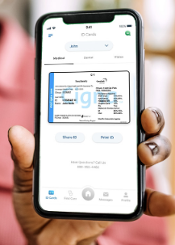
Medical Coverage Highlights
How to access digital ID Card
Log in to myCigna.com or myCigna app
Click on tap “ID Cards”
View your card(s)
Share ID Card
Save to your Apple Wallet

Slide 9
Medical Coverage Highlights Cigna for Retirees Under 65
Preventive Care – getting and staying healthy is important. Most plans include 100% coverage for designated preventive care services received in-network, such as
Screenings for blood pressure, cholesterol and diabetes
Testing for colon cancer
Clinical breast exams and mammograms
Pap test

Slide 10
Medical Coverage Highlights Cigna for Retirees Under 65
What is a PCP?
Primary Care Physician
Pediatrician
Family Practice
General Medicine
Internal Medical
Office visit copay for PCP
$20 (if preventive it is $0)

Slide 11
Medical Coverage Highlights Cigna for Retirees Under 65
EAP – Employee Assistance Program
24/7 access to licensed mental health professionals
Stress, Grief/Death, Substance Abuse, Relationship
Confidential
Benefit for household
No cost
Up to 5 face to face sessions
Unlimited telephonic consultation
(888)371-1125
www.cignabehavioral.com
Employer ID: usvigovernment

Slide 12
Medical Coverage Highlights Cigna for Retirees Under 65
MDLive Virtual Care – convenient phone and video consultation with a board-certified doctor for preventive care or minor injuries
Primary Care
Preventive care, routine care, and specialist referrals
Urgent Care
On-demand care for minor medical conditions
Behavioral Care
Talk therapy and psychiatry from the privacy of home
Dermatology
Care for skin, hair, and nail conditions

Slide 13
Medical Coverage Highlights Cigna for Retirees Under 65
MDLive Virtual Care
Access MDLive by logging into myCigna.com
“Talk to a doctor”
Call (888)726-3171
Select the type of care you need
Medical care or Counseling
Follow prompts

Slide 14
Medical Coverage Highlights Cigna for Retirees Under 65
Air Ambulance
Covered benefit when medical necessity is established by a medical professional
Once medical necessity is determined, the hospital social worker is responsible for arranging in-network air transport
The air ambulance will be directed to the nearest medical facility qualified to treat the prevailing condition
Travel for a family member to accompany the injured member is determined on a case by case basis; the accompanying member must test negative for COVID 19
Return travel from the medical facility is not a covered benefit
Members are responsible for the deductible and 20% coinsurance; then plan pays 80%

Slide 15
PPO Dental Plan – Cigna
Services | In-Network | Out of Network
Calendar Year Deductible | $25/100 | $25/100
Calendar Year Maximum | $1,250 | $1,250
Preventive Care Routine Oral Exams Cleanings | 100% | 75%
Basic Services Fillings, Simple Extractions | 80% after deductible | 50% after deductible
Major Services Crowns, Dentures | 50% after deductible | 40% after deductible
Orthodontia (Children to age 25) Benefit Maximum Benefit | $1,000 50% after deductible

Slide 16
Cigna Onsite Representatives
We are here to support you virtually
Confidential and convenient
Dedicated to serve you as an employee of the Government and assist with:
Benefit questions and/or concerns
Claim issues
Wellness initiatives (i.e. HRA, MotivateMe, etc)
Guidance on mycigna.com or the Cigna Mobile App

Slide 17
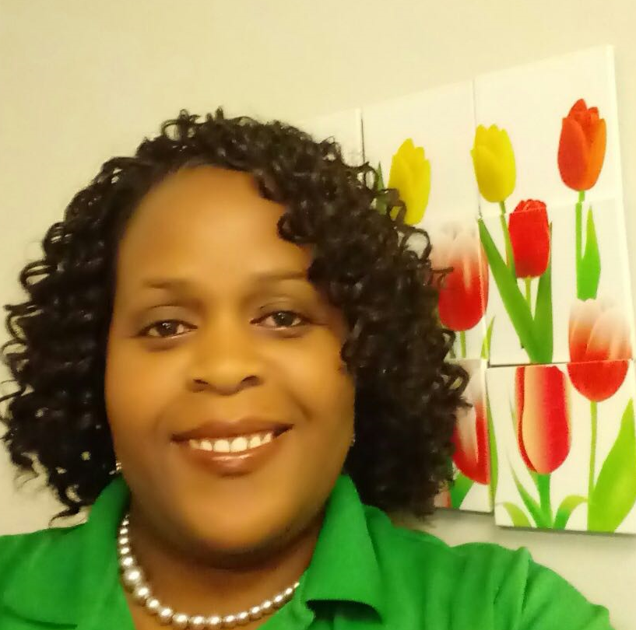
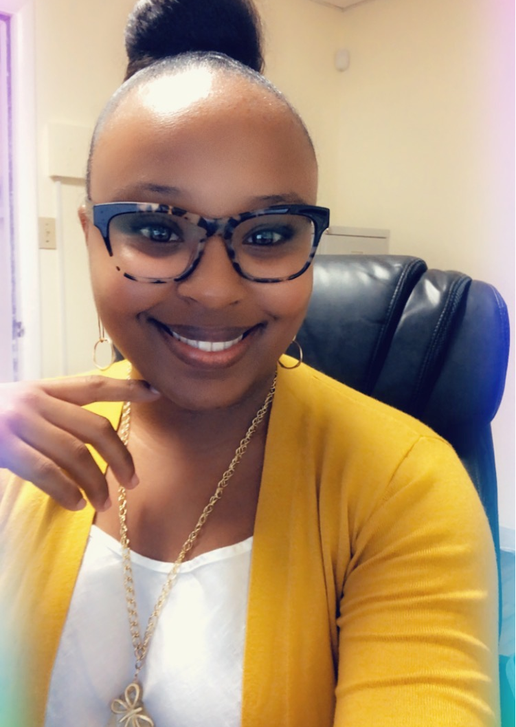
Cigna Members – Onsite Cigna Representatives!
St. Thomas
Jennifer Gumbs-Chinnery
Call: (340) 690-0221
Email: Jennifer.Gumbs-Chinnery@Cigna.com
St. Croix
Shinika Miller
Call: (340) 441-5382
Email: Shinika.Miller@Cigna.com

Slide 18
Meet Your Onsite Health Coaches
Your Onsite Health Coaches are Here to Support You Virtually
Confidential and convenient health coaching is just one more way we’re committed to helping you live a healthier life!
Eat healthier or increase exercise
Lose weight, manage stress, or quit tobacco
Better manage conditions like diabetes, hear disease, high blood pressure, or high cholesterol
Help you understand and access all of the health and wellness benefits available to you

Slide 19
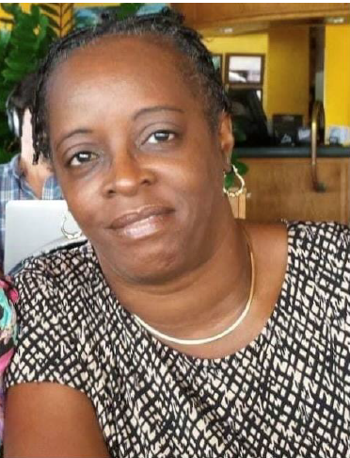
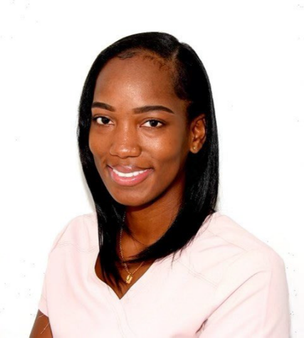
Cigna Members – Schedule Your Health Coaching today!
St. Thomas & St. John
Charlene White-Hewitt, BSN, RN
Call: (340) 514-0395
Email: Charlene.White-Hewitt@Cigna.com
St. Thomas
Shanice Laurent
Call: (340) 473-2907
Email: Shanice.Laurent@evernorth.com

Slide 20
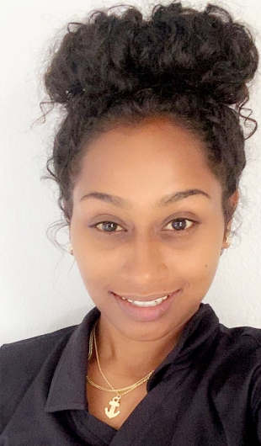
Cigna Members – Schedule Your Health Coaching today!
St. Croix
Ashley Megahy RN, BSN
Call: (340) 719-8080
Email: Ashley.Megahy@evernorth.com
St. Croix
Jameelah Williams, BSN, RN
Call: (340) 244-5627
Email: Jameelah.Williams@Cigna.com

Slide 21
Vision Plan – The Standard
Services | EyeMed Network | Out of Network
Eye Exam (12 months) | $0 Copay | Up to $40 reimbursement
Lenses (12 months) Single Bifocal Trifocal | Covered 100% Covered 100% Covered 100% | Up to $40 reimbursement Up to $60 reimbursement Up to $80 reimbursement
Frames | $150 Retail Allowance then 20% discount | Up to $45 reimbursement
Contact Lenses Elective Medically Necessary | $150 Retail Allowance Covered 100% | Up to $150 reimbursement Up to $210 reimbursement

Slide 22
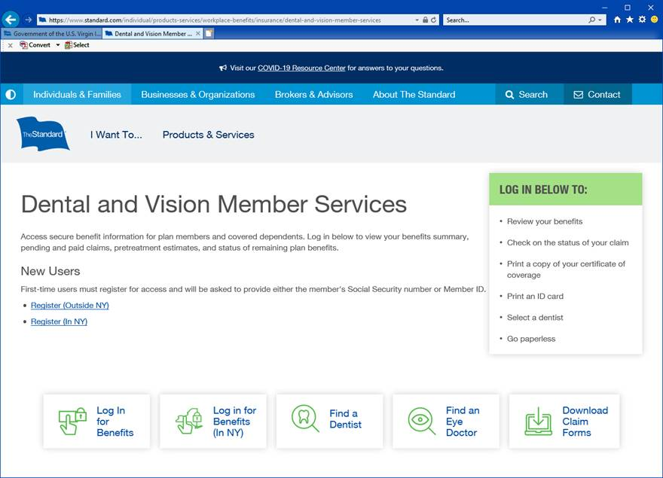
Vision Plan – Standard
www.standard.com/services - EyeMed Access

Slide 23
Basic Life and AD&D – The Standard
Basic Life
Retiree of Central Government receive a flat $5,000 Benefit
Be sure to update beneficiaries
Additional Life
Retirees can apply for additional life insurance up to $150,000
Evidence of Insurability will be required
Medical Questions will need to be answered
Be sure to update beneficiaries
www.standard.com/mybenefits/gvi

Slide 24
Value Added Services – The Standard
Travel Assistance – (800) 872-1414
Available to members and immediate family members when traveling more than 100 miles from home
Travel planning guidance
Assistance replacing lost credit cards and passports, transferring funds and locating missing luggage
Medical and legal assistance
Emergency medical evacuation and repatriation services
Return transportation for dependent children and traveling companions

Slide 25
Value Added Services – The Standard
Life Services Toolkit
Grief and loss support
Books to help children cope
Support Services
Online Resources
Legal services
Employee Services
Online Will template and FAQ
Identity theft prevention
Financial planning online tools
Funeral planning resources
Health and wellness resources

Slide 26
Next Steps - Bentek
www.mybentek.com/gvi
Create an Account as a first-time user
Once created you can log in and do the following:
View benefit elections
View Plan Documents in Resources Section

Slide 27
Bentek Landing Page
Don’t have an account? Create one
Quick How To Videos

Slide 28
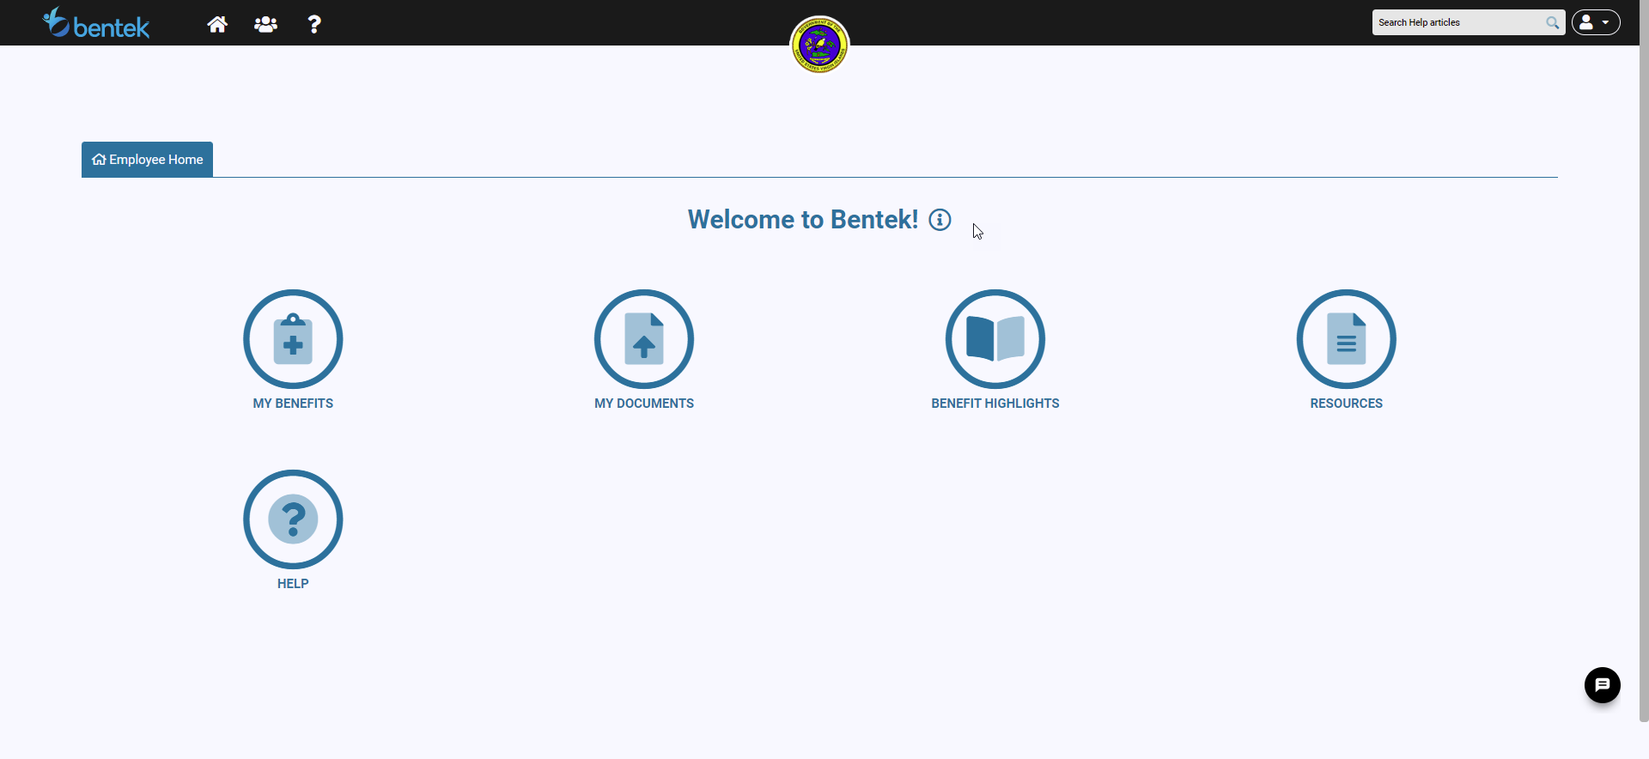
Bentek Launchpad
Click here

Slide 29
Medical Coverage Highlights UHC for Retirees Over 65
UHC Presentation – Sheri Harmon-Butts
Original Medicare Basics
What to expect next
New United Healthcare materials

Slide 30
Questions?
Questions? Or Changes?
Division of Personnel
St. Thomas – (340) 774-8588
St. Croix – (340) 718-8588
Stateside – log into Division of Personnel Website
Download Change Form
Notorize
Mail to Division of Personnel
Technical Questions?
Bentek Helpline – (888) 523-6835
Monday – Friday 8:30am – 5:00pm

