Slide 1
Cardiovascular Health: A Heart-to-Heart Talk
Lyña Fredericks, PhD
Virgin Islands Department of Health
Chronic Disease Director

Slide 2
Topics of Discussion
Definition of Terms
USVI Data
Symptoms
Risk Factors
Risk Reduction
Screening & Diagnosis
Treatment
Rehabilitation

Slide 3
Brain Teasers
There is a difference between cardiovascular disease, heart disease, and coronary heart disease.
I will know when I’m having a heart attack because, I’ll have chest pain.
If heart disease runs in my family, there’s no way to prevent developing it.
Persons under age 25 are not affected by heart disease.
I would know if I have high blood pressure because there would be clear warning signs.
Persons who had a heart attack should avoid exercise.
True or False??

Slide 4
Cardiovascular Disease
Umbrella term that includes all types of diseases that affect the heart or blood vessels
Common Types of Cardiovascular Disease
Heart Disease – a variety of conditions that affect the heart’s structure and function
Stroke – blood vessels in the brain are blocked or burst
Arrythmia – irregular heart rhythm
Heart Failure – heart can’t pump enough blood to meet the body’s needs
Cardiomyopathy – enlarged or stiff heart muscle

Slide 5
Heart Disease
A type of Cardiovascular Disease
Heart Disease is leading cause of death globally, nationally, and locally.
Includes numerous heart conditions
Coronary Artery Disease or Coronary Heart Disease – most common type
Angina – chest pain or discomfort
Heart Attack – lack of blood to the heart muscle
Congenital Heart Disease – hearth conditions present at birth
Healthy Heart
Angina
Heart Attack

Slide 6
Brain Teaser Check
There is a difference between cardiovascular disease, heart disease, and coronary heart disease.
TRUE

Slide 7
What does this mean for Virgin Islanders?
2021 Heart Disease Death Rate: 167.2 per 100,000 population
USVI population: 87,146 (2020 Census Data)
~ 146 persons died from heart disease in the USVI in 2021
Data Source: USVI Bureau of National Vital Statistics

Slide 8
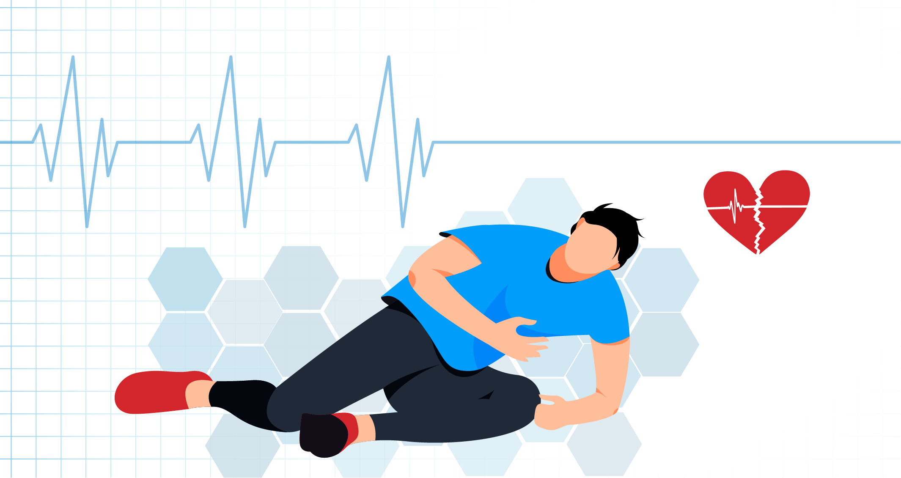
Symptoms
Heart Attack
Chest pain/discomfort; upper back, arm, or neck pain; indigestion; heartburn; nausea or vomiting; extreme fatigue; dizziness; shortness of breath
Arrhythmia
Fluttery feelings in the chest (palpitations)
Heart Failure
Shortness of breath; fatigue; swelling of the feet, ankles, legs, abdomen, or neck veins
Angina
Pain/discomfort in chest, arms or shoulder; weakness; light-headedness; nausea; cold sweat; shortness of breath
Stroke
Sudden numbness/weakness in face, arm, or leg; sudden severe headache; sudden trouble walking, speaking, or seeing; dizziness; loss of balance

Slide 9
Brain Teaser Check
I will know when I’m having a heart attack because, I’ll have chest pain.
FALSE

Slide 10
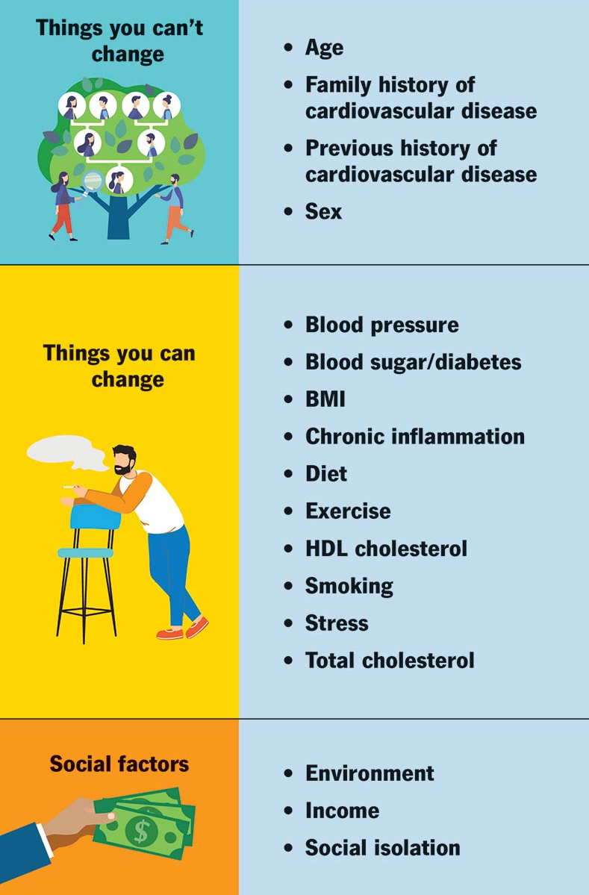
What Factors Increase Your Risk?
Race/Ethnicity
Alcohol Consumption

Slide 11
Brain Teaser Check
Persons under age 25 are not affected by heart disease.
FALSE

Slide 12
Brain Teaser Check
If heart disease runs in my family, there’s no way to prevent developing it.
FALSE

Slide 13
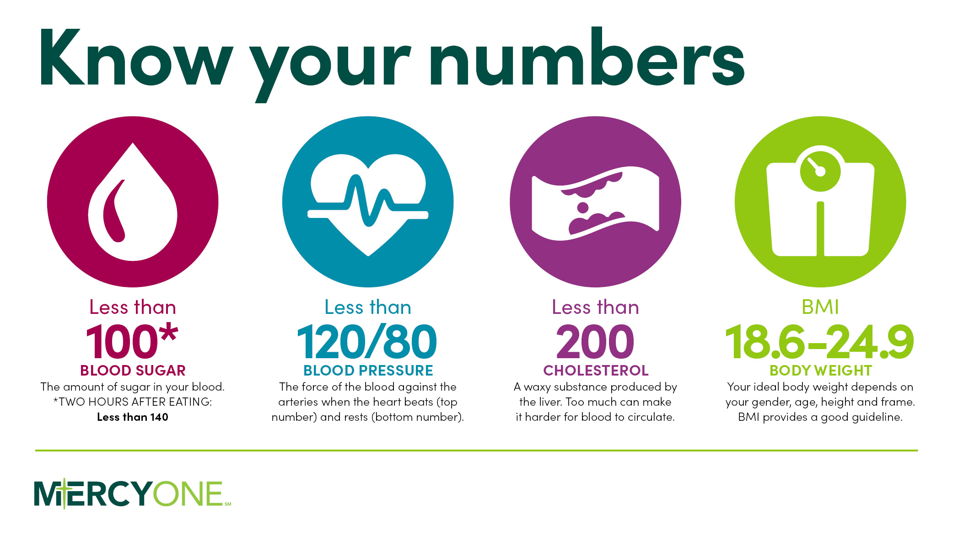
Reducing Your Risk

Slide 14
Hypertension (High Blood Pressure)
“The Silent Killer”

Slide 15
Hypertension (High Blood Pressure)
Mainly caused by poor lifestyle choices
High Sodium/Salt Intake
How much salt is too much salt?
Average daily consumption – 3,400 mg
Recommended – 2,400 mg (1 teaspoon)
Processed/can foods are high in sodium

Slide 16
Brain Teaser Check
I would know if I have high blood pressure because there would be clear warning signs.
FALSE

Slide 17
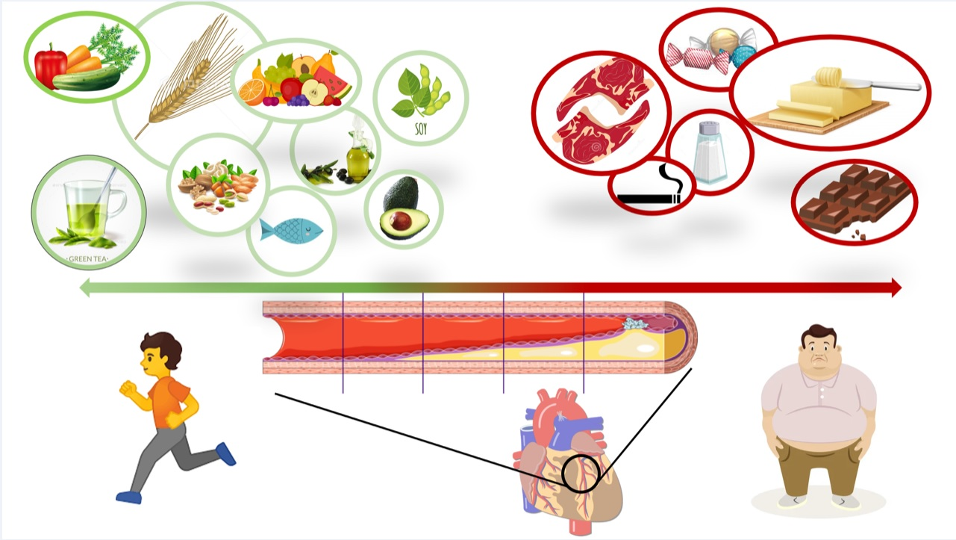
Heart Healthy Lifestyle
At least 150 min. of exercise/week
Quit smoking
Reduce alcohol consumption
Manage Stress
Consume more of the following
Fruits/vegetables
Whole grains & fiber
Egg whites
Lean meats & fish
Healthy Fats e.g., vegetable/canola/olive oil, avocado, nuts
Skim or fat-free milk
Grill, bake, roast, boil, steam or broil foods
Low salt and sugar foods

Slide 18
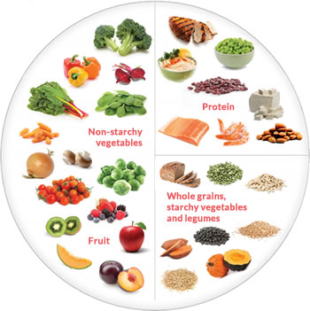
Additional Tips
Plate Method
USDA Food Nutrition Database
https://fdc.nal.usda.gov/
Consult a Registered Dietitian

Slide 19
Screening & Diagnosis
Annual wellness exam to determine risk
Screening Tests
Electrocardiogram (EKG or ECG)
Echocardiogram
Exercise Stress Test
Chest X-Ray
Cardiac Catheterization
Coronary Angiogram
Coronary Artery Calcium Scan

Slide 20
Treatment
Surgery
Lifestyle Changes
Medications
Take medications as prescribed
Do not stop taking medications without talking to your health care provider
Ask questions

Slide 21
Cardiac Rehabilitation
Cardiac rehabilitation aids in recovery from a heart attack, heart failure, or any other heart problem that required surgery or medical care.
Reduces recurrence of a cardiac event and improves quality of life
Includes
Doctor-approved physical activity
Education about healthy living
Healthy eating; taking medications as prescribed; quitting smoking
Stress Reduction

Slide 22
Brain Teaser Check
Persons who had a heart attack should avoid exercise.
FALSE

Slide 25
References
American Heart Association. (2017, May 31). What is cardiovascular disease? Retrieved from https://www.heart.org/en/health-topics/consumer-healthcare/what-is-cardiovascular-disease
American Heart Association. (2021, November 1). How much sodium should I eat per day? Retrieved from https://www.heart.org/en/healthy-living/healthy-eating/eat-smart/sodium/how-much-sodium-should-i-eat-per-day
Centers for Disease Control and Prevention. (2023, April 14). Heart disease. Retrieved from https://www.cdc.gov/heartdisease/index.htm
Medline Plus. (2022, September 2). Heart diseases. Retrieved from https://medlineplus.gov/heartdiseases.html
National Heart Lung and Blood Institute. (2021, October). Know the difference fact sheet. Retrieved from https://www.nhlbi.nih.gov/resources/know-differences-cardiovascular-disease-heart-disease-coronary-heart-disease
U.S. Census Bureau. (2022, October 20). 2020 island areas censuses data on demographic, social, economic and housing characteristics now available for the U.S. Virgin Islands. Retrieved from https://www.census.gov/newsroom/press-releases/2022/2020-island-areas-us-virgin-islands.html#:~:text=In%202020%2C%20the%20U.S.%20Virgin,on%20racial%20and%20ethnic%20composition
U.S. Department of Agriculture. (2023). Food Data Central. Retrieved from https://fdc.nal.usda.gov/
World Health Organization. (2021, June 11). Cardiovascular diseases (CVDs). Retrieved from https://www.who.int/news-room/fact-sheets/detail/cardiovascular-diseases-(cvds)

Slide 26
Email address: lyna.fredericks@doh.vi.gov
Phone Number: 340-774-7477 Ext. 5675

